Slide 1
FET as a switch
Introduction
Wide variety of advantages
high input impedance, simple fabrication, simple operations, High speed etc.
makes the Field Effect Transistors (FETs) to be used popularly in different applications particularly in integrated circuit systems. FETs are the 2nd generation transistors after the BJTs. These can be used as amplifiers in oscilloscopes, testing and measuring instruments, electronic voltmeters, etc. and also used in switching actions.

Slide 2
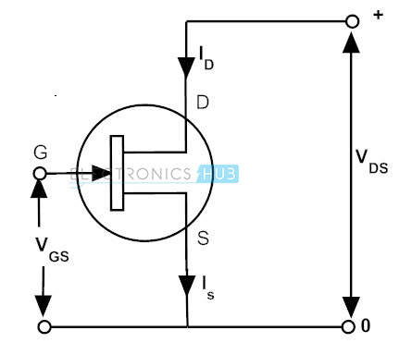
FET and Its Operating Regions

Slide 3
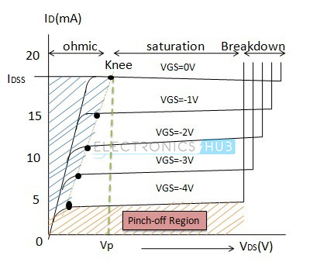
FET and Its Operating Regions

Slide 4
FET and Its Operating Regions
Field Effect Transistor is a unipolar device in which the current is carried only by the majority carriers (either by hoes or electrons).
FET is a voltage controlled device that means, by controlling the voltage between gate and source, the output current gets varied.
Let us consider N channel JFET for understanding the operating regions. The operation or characteristics of JFET divided into three different regions, namely ohmic, saturation and cutoff region. The voltage applied to the drain is termed as V_{DS} (some times also referred as V_{DD}) and the voltage to the gate is termed as V_{GS} or V_{GG}.

Slide 5
FET and Its Operating Regions
Ohmic Region (V_{DS}> 0 and V_{DS} < V_{P})
In this region channel depletion layer is very small and the FET acts as a variable resistor.
In this, the V_{DS} value is greater than zero and less than V_{P} so there is no pinch off of the channel and the current I_{D} increases. When we increase the gate source voltage V_{GS}, the channel conductance falls and the resistance is increased. Therefore, the depletion regions will spread more that makes a narrow channel. The channel resistance changes generally from 100 ohms to 10K ohms and obviously controls the voltage. Hence transistor acts as voltage controlled resistor in this region.

Slide 6
FET and Its Operating Regions
Saturation Region (V_{DS} > V_{GS} – V_{P} )
This region starts from the point where V_{DS} is greater than V_{GS} minus V_{P}, here V_{P} is the pinch-off voltage. In this region, the drain current I_{D} entirely depends on the V_{GS} and not a function of V_{DS}. The FET operates in this region to amplify the signals as well as for switching operations. From the figure it is observed that when V_{GS} is zero, the maximum current I_{D} flows. When we change the V_{GS} more negative, then, the drain current is falling. At a particular value of V_{GS} the drain current flows constantly through the device. Hence, this region is also called constant current region.

Slide 7
FET and Its Operating Regions
Cutoff Region (V_{GS} < V_{P})
This is the region in which the drain current I_{D} is zero and the device is OFF. In this the gate source voltage V_{GS} is less than pinch off voltage V_{P}. This means the value of V_{GS} is more negative than V_{P}. Therefore, the channel closes and doesn’t allow any current flow through the device.

Slide 8
FET as a Switch
From the above discussion, it is clear that the FET can be used as a switch by operating it in two regions, they are cutoff and saturation region. When the V_{GS} is zero the FET operates in saturation region and maximum current flows through it. Hence it is like a fully switched ON condition. Similarly, when the VGS applied is more negative than the pinch off voltage, FET operates in cutoff region and doesn’t allow any current flow through the device. Hence FET is in fully OFF condition. The FET can be used as switch in different configurations, like..

Slide 9
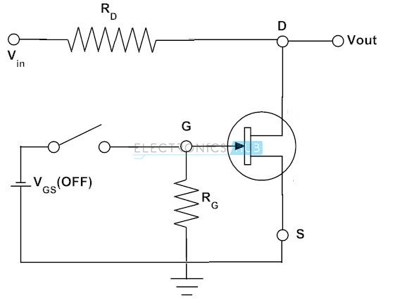
FET Used as a Shunt Switch

Slide 10
FET Used as a Shunt Switch
Let us look at the above figure where FET is connected in parallel with the load and it acts like an analog switch.
When the VGS applied is zero the FET is turned ON by operating in saturation region and its resistance is very small nearly 100 ohms. The output voltage across the across the FET is V_{OUT}= V_{in} * {R_{DS}/ (R_{D} + R_{DS (ON)})}. Since the resistance R_{D} is very large, the output voltage is approximately considered as zero.
When we apply the negative voltage which is equal to the pinch off voltage at the gate, FET operates in the cutoff region and acts as a high resistance device and the output voltage is equal to the input voltage.

Slide 11
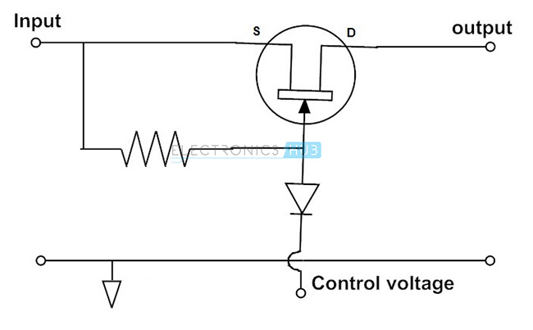
FET Used as a Series Switch

Slide 12
FET Used as a Series Switch
Above figure shows another configuration of FET switch circuit. In this circuit FET acts as a series switch. It acts as a closed switch if the control voltage is zero and open switch if control voltage is negative. When the FET is ON, the input signal will appear at the output and when it is OFF the output is zero.

Slide 13
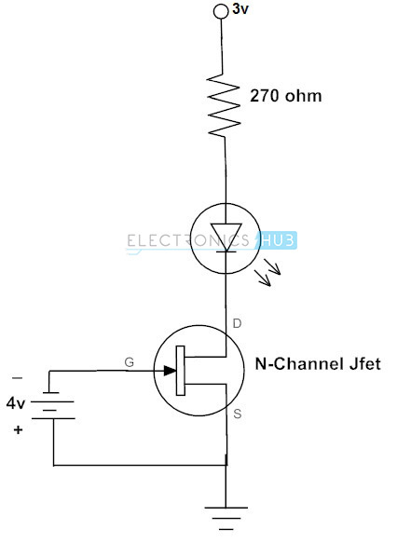
Ex. of N-Channel JFET as a Switch

Slide 14
Ex. of N-Channel JFET as a Switch
The above figure demonstrates how a N-channel JFET used to switch the LED. The LED is connected between supply and source terminal through a resistor. Here resistor is used to limit the current through the LED. Gate terminal of the transistor connected to the negative supply.
From the above discussion, zero voltage on the gate terminal makes current to flow through the LED because FET is in saturation mode. Therefore, the LED becomes ON.
With a sufficient negative voltage on the gate terminal (about 3-4 volts), JFET drives into cutoff mode so the LED becomes turned OFF.

Slide 15
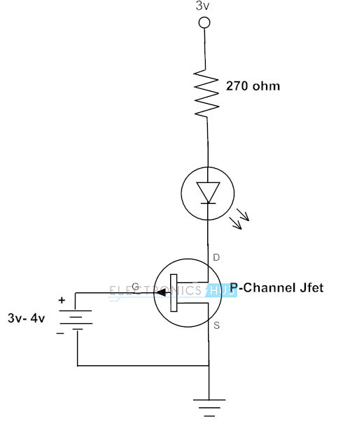
Ex. of P-Channel JFET as a Switch

Slide 16
Ex. of N-Channel JFET as a Switch
Similar to the N-channel JFET driven LED, P-channel JFET switched LED circuit is given above. The difference between the two circuits is the supply source at the gate terminal.
Turn ON condition remains same for both circuits that is zero voltage at the gate terminal causes the LED to glow as the FET is active.
For switching the FET into cutoff, a sufficient positive voltage (about 3 to 4 volts in this case) stops the current flow through the circuit. Therefore the LED is turned OFF. We can also use FETs for turning the relay circuits, motor drivers, and other electronic controlling circuits.

Slide 17
MOSFET as a Switch

Slide 18
MOSFET as a Switch

Slide 19
MOSFET as a Switch
Another type of FET is a MOSFET which is also a voltage controlled device. The level of V_{GS} at which the drain current will increase or starts flowing is called threshold voltage V_{T}. Therefore, if we increase the V_{GS}, the drain current also increases. And if we increase the V_{GS} by keeping the V_{DS} constant, then the drain current will reach to a saturation level as in the case of JFET.
MOSFET operates in the cutoff mode when V_{GS} is below the threshold level. Therefore, no drain current flows in this mode. Hence acts as OPEN switch
For a better understanding consider the below figure where N-channel enhancement type MOSFET is switched for different voltages at the gate terminal.

Slide 20
MOSFET as a Switch
In the below figure, MOSFET gate terminal is connected to V_{DD}, so that the voltage applied at gate terminal is maximum. This makes the channel resistance becomes so small and allows maximum drain current to flow. This is called as saturation mode and in this mode the MOSFET is completely turned ON as a closed switch. For P-channel enhancement MOSFET, for turning ON, gate potential must be more negative with respect to source.
In cutoff region, V_{GS} applied is less than the threshold voltage level so the drain current is zero. Hence, the MOSFET is in OFF mode just as open switch as shown in figure.

Slide 21
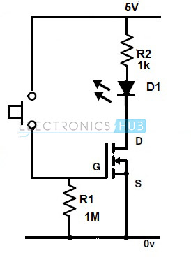
Ex. of MOSFET as a Switch

Slide 22
Ex. of MOSFET as a Switch

Slide 23
MOSFET as a Switch
Most of the circuits use MOSFET as switch compared to JFET due to the advantages offered by it. We can also use switching circuit (to operate the load at particular switching frequency) for the JFETs and MOSFETs for getting the PWM signals based on the load requirements.

